Slide 1

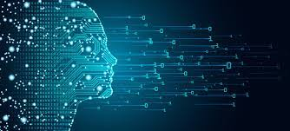
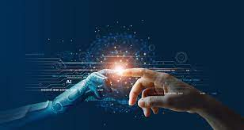
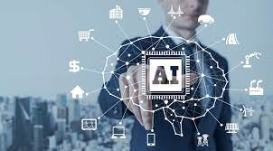
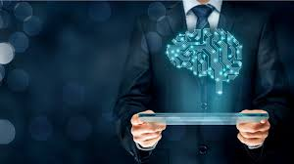
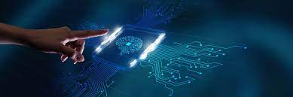
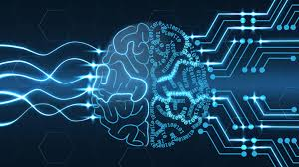
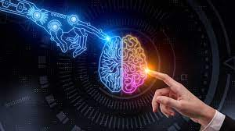
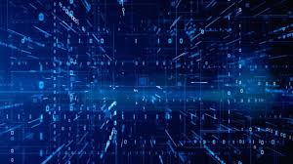
AI and ds project
TEAM MEMBERS:​
S.J SUMANTH(2010030377)​
K. SREEVARUN(200030451)​
E. PAVAN SAI(2010030538)​
E. SHIVA GOUD(2010030542)​

Slide 2

OUTLINE :
Introduction and Problem context
Problem Statement
Problem in existing system
Objectives
Conclusion

Slide 3
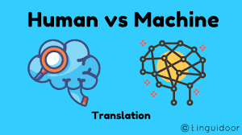
INTRODUCTION
And
Problem context
Machine translation : Machine Translation has been
defined as the process that utilizes computer software to
translate text from one natural language(such as English)
to another (such as Arabic).
Natural language processing (NLP) is the ability of a
computer program to understand human language as it is
spoken and written- referred to as natural language. It is
a component of artificial intelligence
A translator must interpret and analyze all of the elements in the text and know how each word may influence another. This requires extensive expertise in grammar, syntax (sentence structure), semantics (meanings), etc., in the source and target languages, as well as familiarity with each local region.

Slide 4
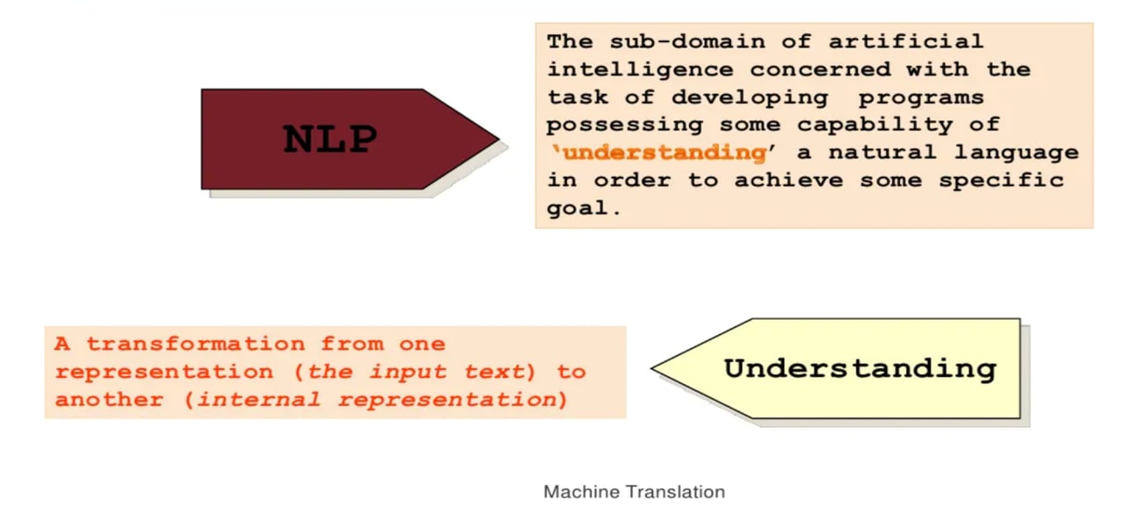

Slide 5


PROBLEM STATEMENT :
In the present world different people speak different languages. Learning and understanding each language is difficult as well as time consuming.
So, we produced an idea to solve this problem. We will build a language translator app using artificial intelligence which makes the communication easy. This app also helps people to deliver information in multiple languages.

Slide 6
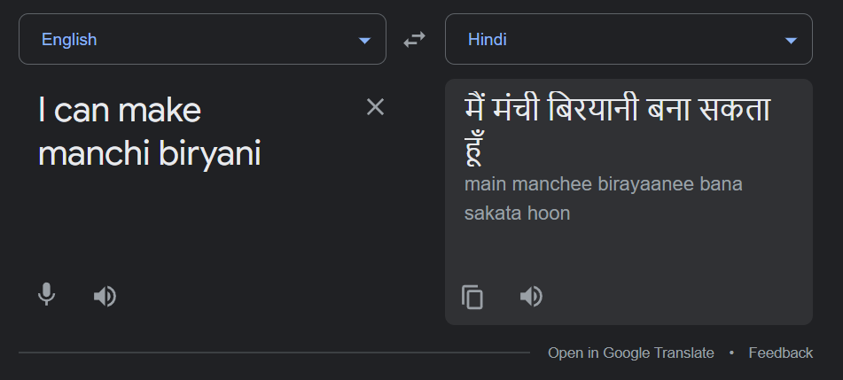








Problems faced by existing system
Most translators that we find on web are used to translate one language to another, then what if a person speaks a bilingual conversation…? It translates one language and leaves the unrecognized words unchanged.
This problem occurs while translating a real-time conversation as we use words of different languages when we speak.

Slide 7

Bilingual Translator

Slide 8
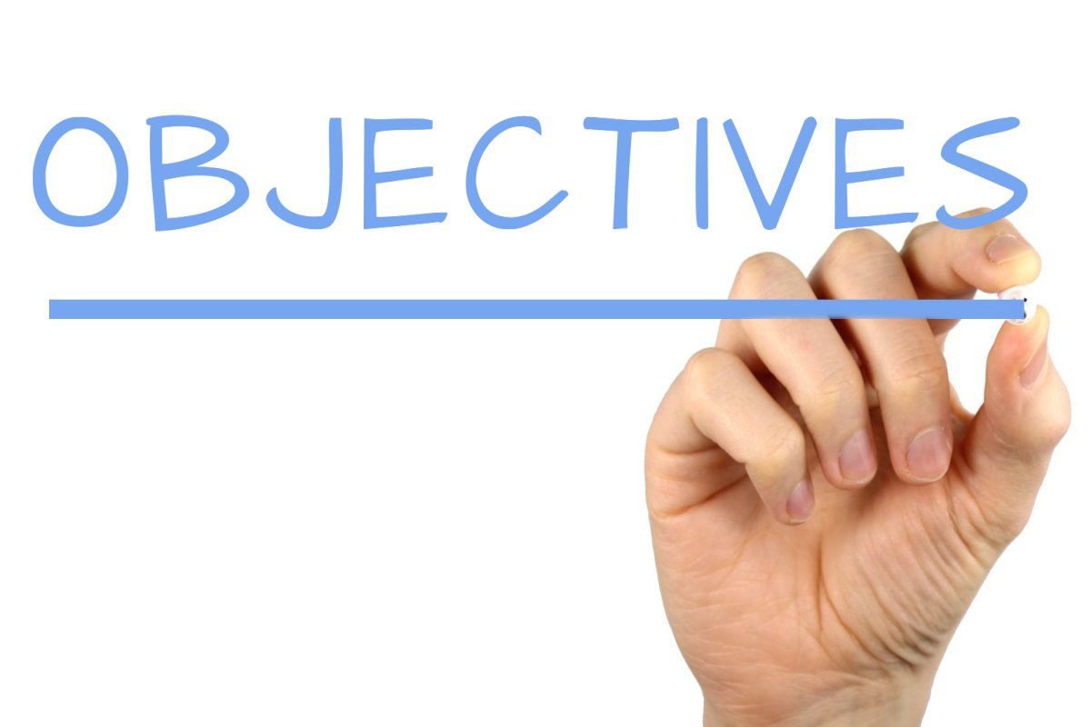
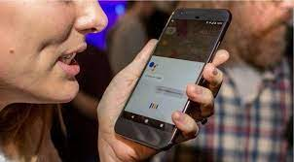
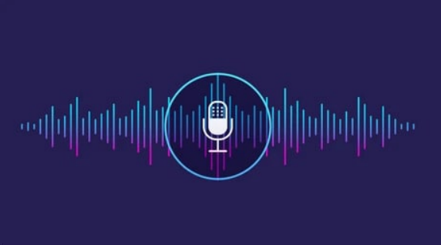
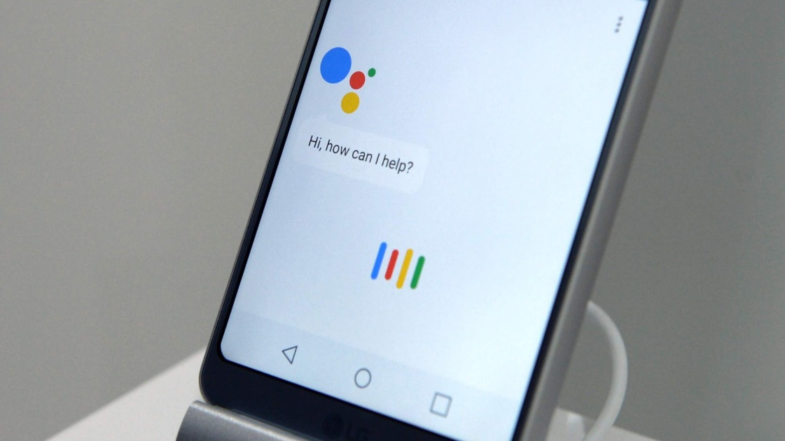



1.Our main objective is to implement mixed language translation.
I will make మంచి cake
मैं मांची केक बनाऊंगा

Slide 9

Implementation steps:
Step - 1:
INPUT:
The user needs to give input through microphone in the form of audio or the user can give the input in the form of text.
If the user gives the input in the form of audio, the pyaudio package will analyze/detect the speech.
Working of pyaudio:
PyAudio provides Python bindings for PortAudio, the cross-platform
audio I/O library. With PyAudio, we can easily use Python to play and
record audio on a variety of platforms.

Slide 10
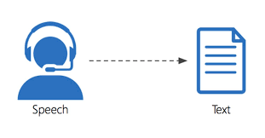
Step – 2:
Convert the audio into text by using SpeechRecognition API.
Working SpeechRecognition API:
Speech recognition software works by breaking down the audio of a speech recording into individual sounds, analyzing each sound, using algorithms to find the most probable word fit in that language, and transcribing those sounds into text.
A speech recognition algorithm or voice recognition algorithm is used in speech recognition technology to convert voice to text.

Slide 11
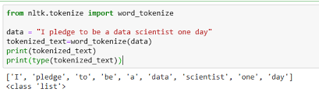
Step - 3:
The input received will be divided into tokens using word_tokenize() function.
The pycld2 package in python analyzes every token and calculates number of English words and non-English words.
Working of pycld2:
For detecting English and non-English words we are using one of the python packages pycld2.

Slide 12
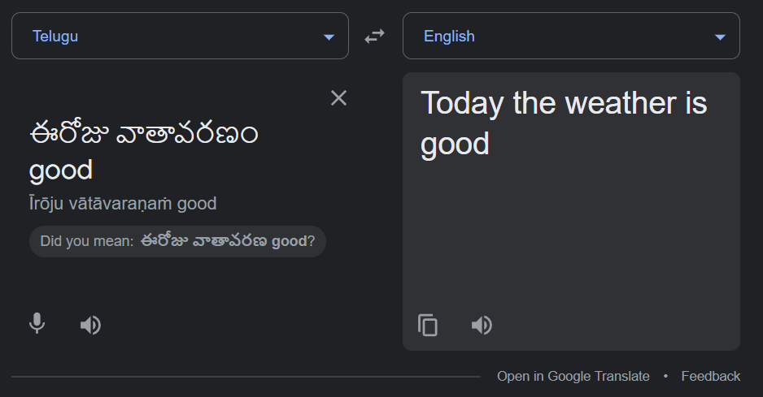
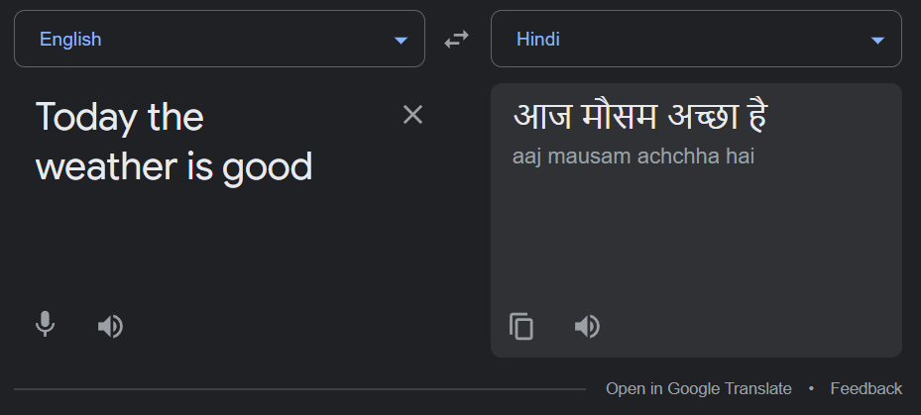
Step - 4:
If the sentence contains more Telugu words and less English words, then we convert complete sentence to English and then translate to Hindi.

Slide 13
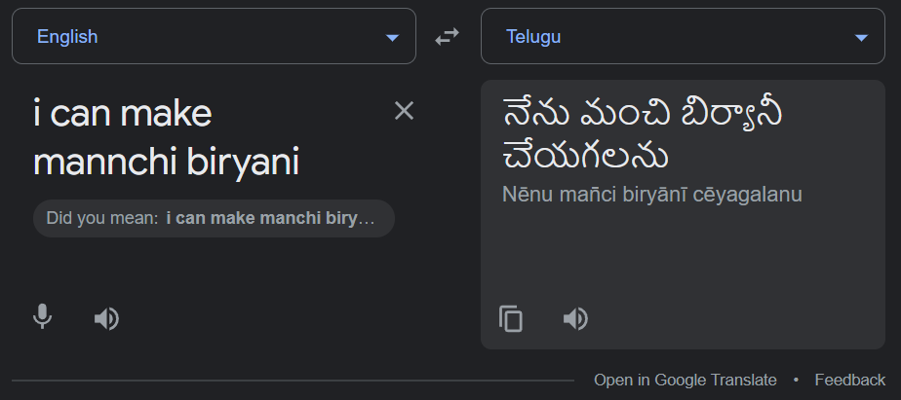
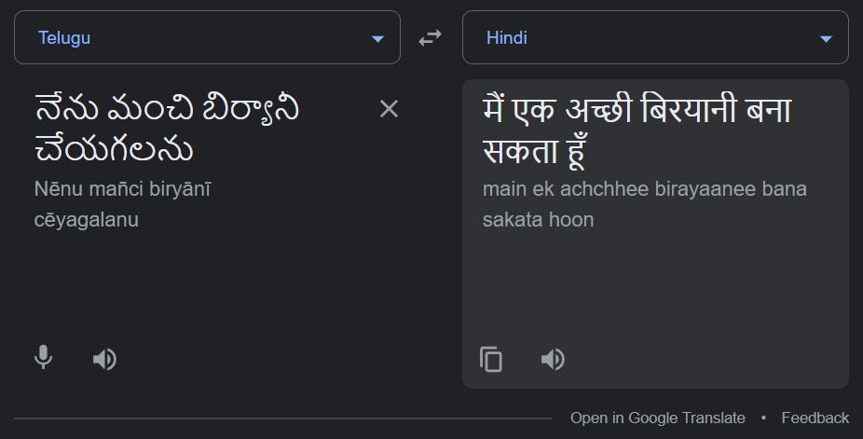
Step - 5:
Else the sentence contains more English words and less Telugu words, then we convert complete sentence to Telugu and then translate to Hindi.

Slide 14

Step - 6:
Output the translated sentence in the form of audio using gTTS API.
Working of gTTS API:
There are several APIs available to convert text to speech in Python. One of such APIs is the Google Text to Speech API commonly known as the gTTS API. gTTS is a very easy to use tool which converts the text entered, into audio which can be saved as a mp3 file.

Slide 15
Flow chart
Input a sentence in the form of audio or text
If it is in the form of audio convert it into text using SpeechRecognition API
Divide the sentence into tokens and analyze it using pycld2 package
If English words are greater than Telugu words convert the text into Telugu and translate to Hindi
If English words are less than Telugu words convert the text into English and translate to Hindi
Output the translated sentence in the form of audio by using gTTS API

Slide 16
Working of pycld2:
The module exports these global constants:
cld2.ENCODINGS: list of the encoding names CLD.
cld2.LANGUAGES: list of languages and their codes.
cld2.EXTERNAL_LANGUAGES: list of external languages and their codes. Note that external languages cannot be hinted, but may be matched if you pass includeExtendedLanguages=True (the default).
cld2.DETECTED_LANGUAGES: list of all detectable languages, as best I can determine.

Slide 17
CONCLUSION
In today’s world, Machine translation creates an ability to balance cost, quality, and time.
The field of machine translation has seen major changes in the last few years. Currently a large amount of research is being done into machine translation.
There is no bilingual translator till today , so we want develop our project in that perspective.

Slide 18


